Slide 1
Fake Review Classification and Topic Modeling
BY
MATHESH M

Slide 2
AGENDA
Introduction
Problem Statement
Business Use Cases
Approach Overview
Preprocessing
MACHINE LEARNING MODELS
DEEP LEARNING MODELS
Transformer pre trained model
Topic Modelling
Clustering
Results
Conclusion

Slide 3
Introduction
The project aims to address the increasing challenge of fake reviews in the e-commerce space by developing robust systems to:
Detect and classify reviews as fake or genuine.
Group reviews into meaningful clusters to identify patterns.
Extract key topics to derive actionable business insights.
Domain: E-Commerce & NLP
The project lies at the intersection of E-Commerce and Natural Language Processing (NLP), leveraging advanced machine learning and NLP techniques to analyze review text.

Slide 4
Problem Statement
Challenge:
Fake reviews have become a significant challenge in the e-commerce landscape, impacting both consumers and businesses. Key challenges include:
Consumer Trust
Business Credibility
Revenue Impact
Need:
There is an urgent need to develop a system that can:
Identify Fake Reviews
Address Misinformation
Extract Actionable Insights

Slide 5
Approach Overview
DATA PREPROCESSING
MACHINE LEARNING MODELS ANALYSIS
DEEP LEARNING MODEL ANALYSIS
TRANSFORMERS –PRE TRAINED MODEL
TOPIC MODELLING
CLUSTERING

Slide 6
DATA PREPROCESSING
Data Cleaning
Tokenization
Stop-word Removal
Split the Dataset
(80-20)
Feature Extraction
(TF-IDF)
Stemming or Lemmetization

Slide 7
CLASSIFICATION MODEL
Logistic Regression
RNN Model
Naive Bayes
ML MODELS
Decision Tree model
DL MODELS
Bi LSTM Model
LSTM Model
SVM
Random Forest Classifier

Slide 8
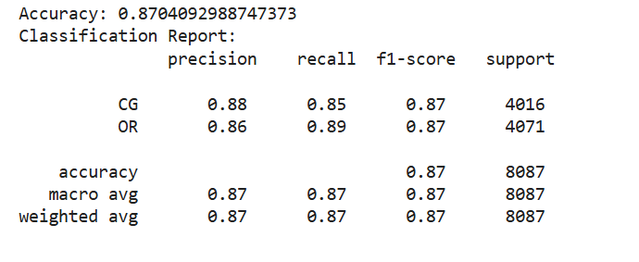
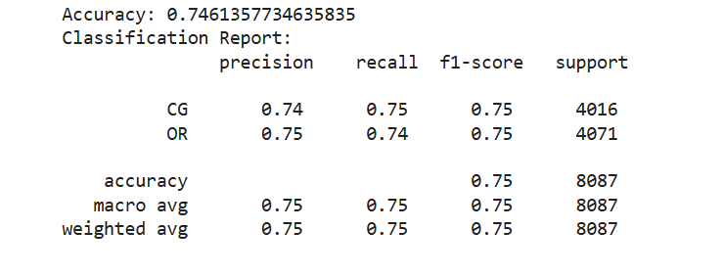
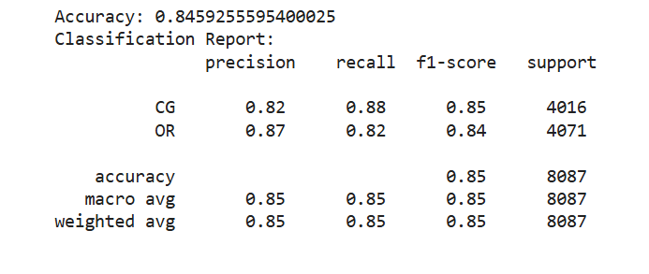
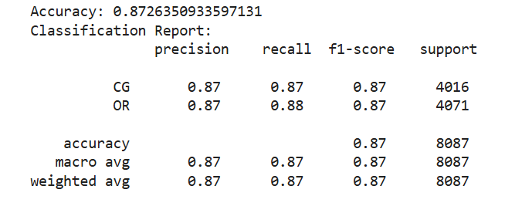

Logistic Regression
Decision Tree model
ML MODELS
Random Forest Classifier
SVM
Naive Bayes

Slide 9
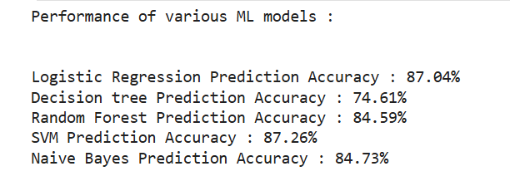
OVERALL PERFORMANCE

Slide 10
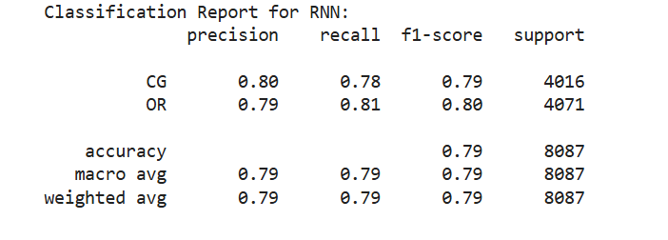
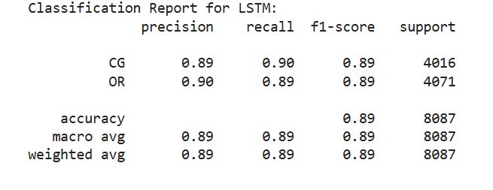
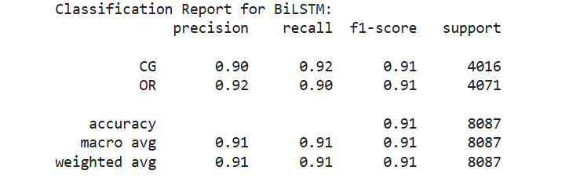
RNN Model
LSTM Model
DL MODELS
Bi LSTM Model

Slide 11
TRANSFORMERS
Data Preparation.
Data Preprocessing.
Tokenization(DistilBERT tokenizer )
Truncation and padding
Model Selection.
Pre-trained model DistilBERT (distilbert-base-uncased)
Training Setup.
Evaluation Metrics.

Slide 12
RESULT ANALYSIS
Epoch 1
Epoch 2
Epoch 3
Accuracy: 90.82%
F1-scores
CG :91.11%
OR :90.52%
Accuracy: 92.20%
F1-scores
CG:92.41 %
OR:91.97 %
Accuracy: 93.03%
F1-scores
CG: 93.10 %
OR: 92.95 %
Final Test Results…..
Accuracy: 93.03%.
Detailed classification report showed balanced performance across both labels, with high precision and recall values

Slide 13
TOPIC MODELLING
Data Preparation.
Feature Extraction
Model Training
Latent Dirichlet Allocation (LDA) model
Non-Negative Matrix Factorization (NMF)
Topic Display Data Preparation
Visualization
WordClouds

Slide 14
Overview of K-Means Clustering
K-Means clustering is an unsupervised learning algorithm used to partition data into a predefined number of groups, or clusters, based on similarity.
The goal is to group similar data points together, minimizing the intra-cluster distance and maximizing the inter-cluster distance.
Cluster overview:
Cluster 0 : Product/Practical use
Cluster 1: Book Reviews
Cluster 2: Pet Products
Cluster 3: Clothing and Accessories
Cluster 4: Movie and Entertainment

Slide 15
CONCLUSION
The analysis successfully applied machine learning techniques, including K-Means clustering and topic modeling, to uncover valuable insights from the textual data. By clustering reviews into distinct groups, we identified unique patterns and themes that highlight customer sentiments, preferences, and concerns. Additionally, advanced models like Latent Dirichlet Allocation (LDA) and Non-Negative Matrix Factorization (NMF) were employed for topic modeling, providing a deeper understanding of the prevalent topics in the dataset.
These models not only revealed actionable insights but also demonstrated the effectiveness of machine learning in processing and interpreting large volumes of unstructured text data. By combining clustering and topic modeling, the analysis provided a comprehensive view of the data, enabling data-driven decision-making and targeted strategies for improving business outcomes

Slide 16
THANK YOU

